Slide 1
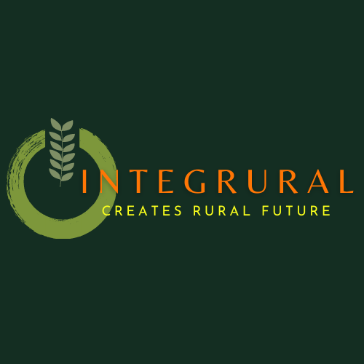
Cultural Heritage and rural sustainability
Blended mobility of VET learners
The European Commission’s support for the production of this publication does not constitute an endorsement of the contents, which reflect the views only of the authors, and the Commission cannot be held responsible for any use which may be made of the information contained therein.
ID 2020-1-EL01-KA202-079113

Slide 2
Intangible Cultural Heritage and traditional planting methods
1
Sustainable Agriculture
2
Plants, methods, “ethos”
Key points
3
Drystone cultivation beds
4
The testimony of manuscripts
5
From old wisdom to new marketing
6

Slide 3
With the notion “Intangible Cultural Heritage” we define the elements of cultural identity and knowledge of the past that shape a certain community. Rites, customs, music, songs, traditional products (and the process of making them), languages/dialects and other elements of everyday life which have been inherited from previous generations can be acknowledged as parts of a nation’s or state’s cultural heritage. UNESCO has been cataloguing intangible cultural heritage of humanity with the aid of national ministries of culture. Every year there are more elements added. Hence, the list comprises for example Falconry or the art of glass beads in Italy, the summer solstice fire festivals of the Pyrenees and the manual bell ringing in Spain, the Fado and the Black Pottery manufacturing of Bisalhaes in Portugal, the Momoeria and Polyphonic tradition of Epirus in Greece…
2. Defining Intangible Cultural Heritage

Slide 4
Sustainable agriculture is the rural production which aims at meeting the population’s needs in food, textiles and other goods without compromising the future capacity of the natural environment to yield these products. In general it is based on a thorough understanding of the ecosystem, which is protected and sustained.
Agriculture was sustainable for several millenia, before the Industrial Revolution. Traditional farming techniques replaced the vital elements that specific cultures absorbed through planting different plants every second year. Without concrete geological analysis, farmers knew which soil was suitable for which plants. And the processing of products was based on long-established practices and methods which passed on from generation to generation.
3. Sustainable Agriculture and its relation to Cultural Heritage

Slide 5
Have you heard the term “forgotten legumes”/ “legumes oubliees”? It refers to plants that had for long been marginalized in our modern diet, due to the fact that their taste was not so good or that they were hard to peel and prepare. And yet, these vegetables have become fashionable again, due to their high benefits for human health. Turnips, parsnips, Matock beans, split peas, lentils are some of the “forgotten” legumes which nowadays have become modern again due to the search for low-fat, high-protein or high-vitamine products. These products are usually produced with ecological methods. These methods, inspired by traditional practices slightly improved through scientific observation, apply to almost all agricultural products, if the farmers want to market their products as “bio”. More than the actual plants or methods, though, what differentiates sustainable farming is the difference in ethos, in the frame of mind of farmers, who don’t aim at the maximization of profit but, rather, at the minimization of ecological footprint.
4. A different frame of mind: Plants, methods, ethos

Slide 6
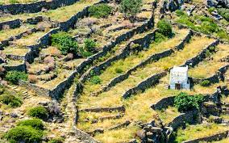
Drystone constructions are common in many rural areas all over Europe and beyond. In the North they have been mainly used for separating land properties and creating paths among them. In the dry Mediterranean South, people constructed drystone cultivation beds on mountain slopes, in order to avoid precious soil from being carried away by heavy rainfalls. In Italy, drystone constructions have entered the UNESCO intangible heritage list, although they are to be found also in other countries. Unfortunately, they are no longer used for cultivation as in many places tourism has replaced agriculture as the basic mode of existence.
5. EXAMPLE: Drystone Cultivation beds

Slide 7
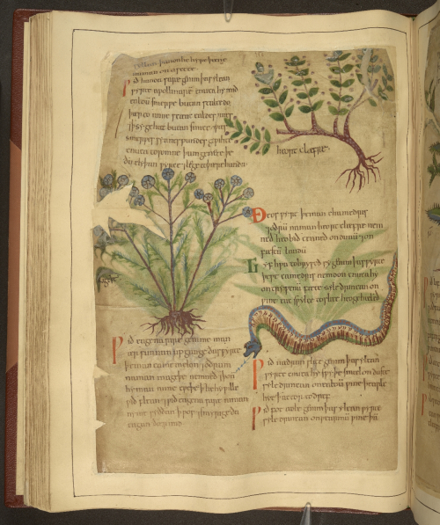
Historical and archaeological research can help us with discovering “forgotten legumes”, old medicaments, traditional recipes. Archaeologists, for example, are discovering seeds which attest to people’s nutritional habits. Historians, on the other hand, discover information on plants and products as well as recipes for food or medicaments in manuscripts of previous centuries. Nowadays, this kind of research has become fashionable again, as we are pursuing an effort to reduce the use of chemical products and go back to a more natural diet and lifestyle.
6. The testimony of manuscripts

Slide 8
This kind of exploitation of historic and archaeological resources is currently undertaken not only by individuals, but also by companies. Hence, the degree of introducing inherited knowledge into modern practices escalates from home-made products to large series marketed by professional marketeers.
6. From old wisdom to new marketing

Slide 9
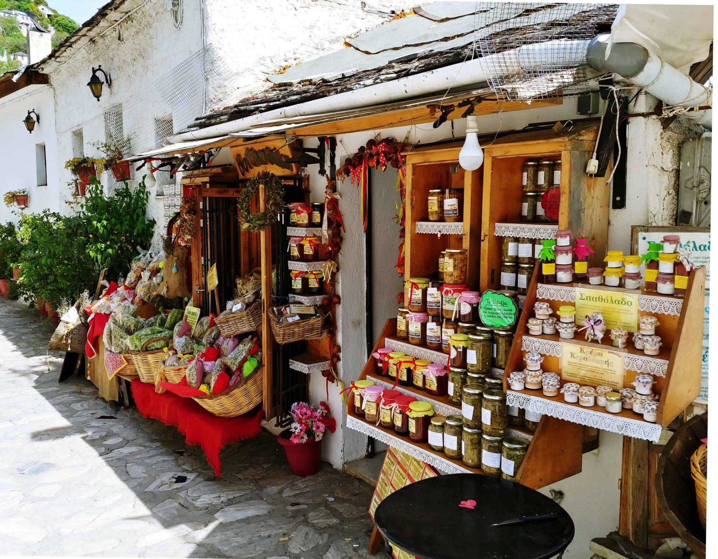
A dusty grandma’s recipe-book can be the inspiration of a home-based family business of traditional sweets, marmalades or ointments. These home-made products can be distributed to the local market and provide the family with an additional income. They are usually popular among tourists, as they offer a sense of “authentic” local gastronomy.
6. a. Home-made

Slide 10
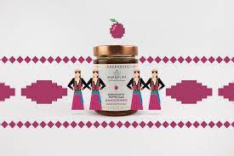
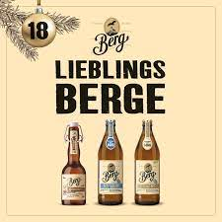
On a second level, local-based small industries and manufactures use natural ingredients to make products that can be marketable on a regional level. Some of them deliberately don’t send their products very far in order to avoid a heavy environmental imprint. Others use local cultural elements to brand their products, thus mingling heritage and production.
6. b. Manufacture

Slide 11
6. c. Industry
There are, however, industrial firms which still use “old wisdom” blended with modern science to produce cosmetics, food or clothing which are eco-friendly and based on natural ingredients.

Slide 12
Many such products are made using a contract base relation with specific producers to guarantee the quality of the primary material. This is usually communicated to the final customers.
Other products are marketed only on a local/regional level with the option of the occasional e-shop.
Finally, there are those which retain only the “flavour” of the original primary material and follow the branding and marketing structures of large-scale industrial production.
6.d. Branding and marketing

Slide 13
Cultural Heritage can influence the way of production, the modes of cultivation and the branding of locally produced goods. Traditional cultivation practices, heritage recipes and usage of local ingredients as well as of local artistic patterns for marketing guarantee not only the better quality of products but also the preservation of a local character and the sense of a strong identity.
7. Conclusion

