Slide 1
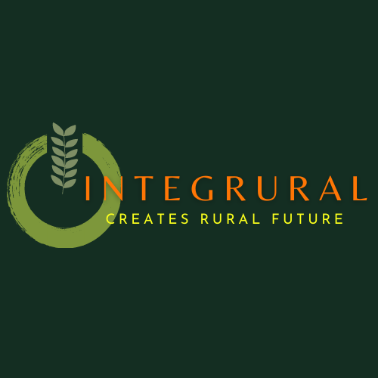
Know and implement the sustainable development goals (SDG) in the workplace
Blended mobility of VET learners
Training Material
António Pirra
Carlos Fonseca
Octávio Sacramento
Pedro Gabriel Silva
Verónika Joukes
The European Commission’s support for the production of this publication does not constitute an endorsement of the contents, which reflect the views only of the authors, and the Commission cannot be held responsible for any use which may be made of the information contained therein.
ID 2020-1-EL01-KA202-079113

Slide 2
INTRODUCTION
This material is oriented to those that want to have some basic, general skills, advices and tips to implement the Sustainable Development Goals (SDGs) and global thinking in their work environment.

Slide 3
CONTENTS
1. Sustainability definition
2. The sustainability pillars
3. Elements of sustainability
4. Mapping and characterization of the 17 SDGs
5. Progress in the implementation of the SDGs in the EU
6. EU rural development policy and SDGs
7. Implementation of SDG - Food and Agriculture Business Principles
8. SDGs implementation by micro entrepreneurs and innovators in rural
contexts – a broader look
9. SDGs implementation by micro entrepreneurs and innovators in rural
contexts – a closer look

Slide 4
CONTENTS (cont.)
10. SDGs implementation by micro entrepreneurs and innovators in rural
contexts – challenges;
11. Implementation of SDG by the states, communities and companies – case
studies and good practices
12. Implementation of SDG by the states, communities and companies – sites
13. Enter into action mode: things to reflect on/to do
14. Some examples of already well known everyday life basic sustainability
actions

Slide 5
1. Sustainability definition
The origins of the sustainability concept lay in the Brundtland report, where the United Nation’s World Commission on Environment and Development (WCED) defined sustainable development in 1987 as development capable “to ensure that it meets the needs of the present without compromising the ability of future generations to meet their own needs” (WCED, 1987, p. 16). If you want to live according to this precept, you have to work on three levels simultaneously: the economic, environmental and social pillars of sustainability.
Meanwhile the United Nations ameliorated and transformed this definition formulating the sustainable development goals (SDG). Until 2030 the whole world should join forces to realize them in order to secure the survival of the planet, guarantying well-being for all. In other words, “they address the global challenges we face, including those related to poverty, inequality, climate change, environmental degradation, peace and justice” (United Nations, 2015).

Slide 6
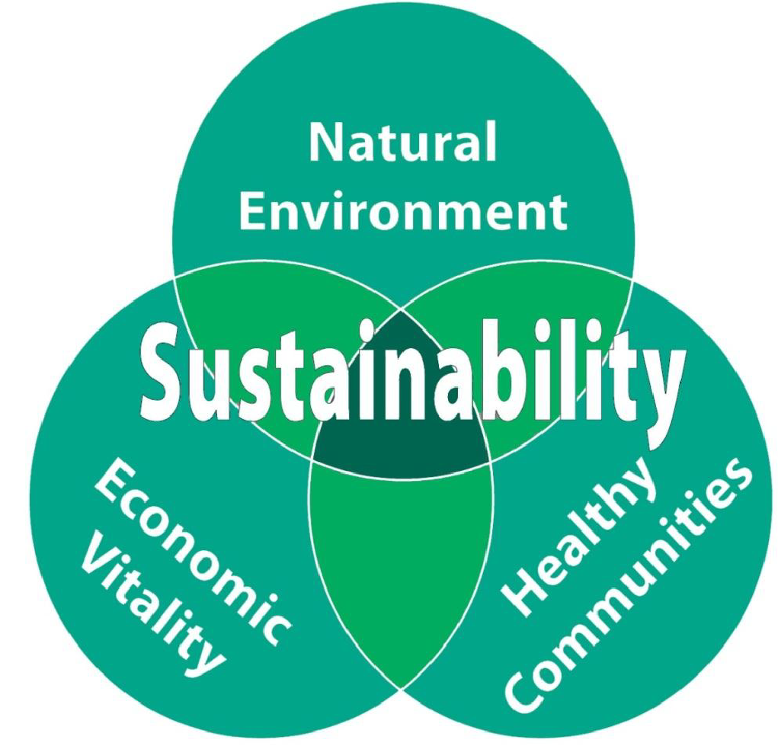
2. The sustainability pillars
Economy
Environmental
Social
https://careers.snclavalin.com/blogs/2022-3/three-pillars-of-sustainability-and-the-built-environment

Slide 7
Economy: money and capital; employment; technological growth; investment; market forces Environment: biodiversity; materials; energy; biophysical interactions Social: human diversity, (cultural, linguistic, ethnic) equity; quality of life; institutional structures; organizational/political structures
3. Elements of sustainability

Slide 8
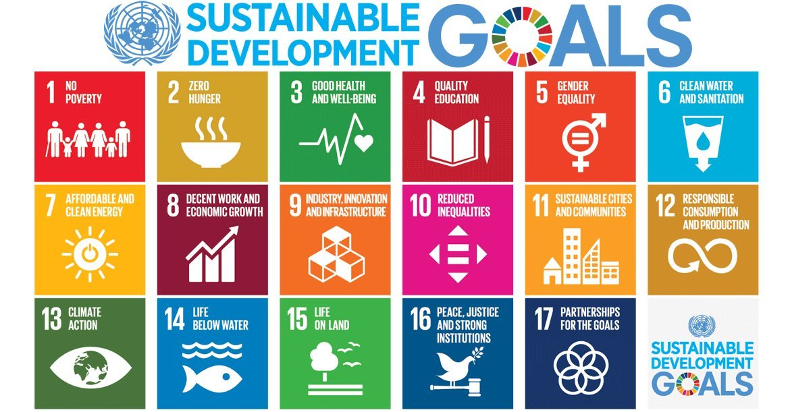
4. Mapping and characterization of the 17 SDGs
The United Nations promote the realisation of the sustainable development goals (SDG) until 2030 as a way to secure the survival of the planet, guarantying well-being for all. It concerns 17 goals, 169 targets and 230 global indicators. The latter being “a robust framework intended for follow-up and review of progress at the global level towards achieving the 17 SDGs”. Thanks to social media the SDG are becoming ever more present in our daily lives. One example being that most of us are meanwhile familiarized with this colourful visual:

Slide 9
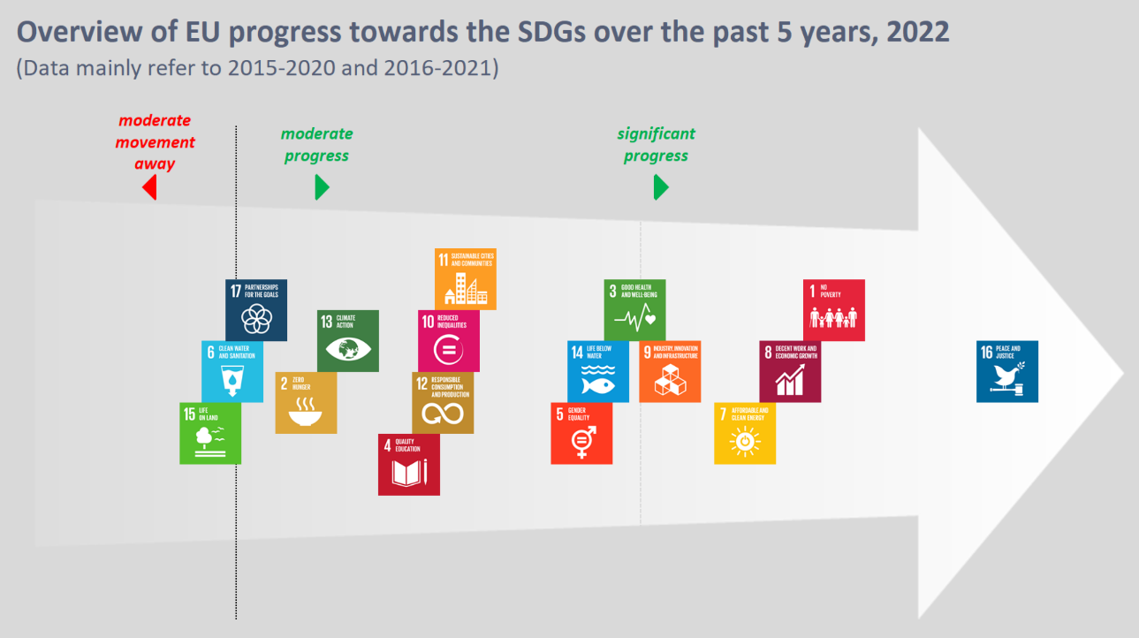
5. Progress in the implementation of the SDGs in the EU
https://ec.europa.eu/eurostat/web/sdi/key-findings

Slide 10
5. Progress in the implementation of the SDGs in the EU (cont.)
Strong progress *
Good progress
Moderate progress:
No progress #
SDG 16 – Peace and Justice
SDG 1 - Reducing poverty and social exclusion
SDG 8 – Decent work and economic growth
SDG7 - Clean and affordable energy
SDG9 - Innovation and infrastructure
SDG 3 - Well-being
SDG 14 - Life below water
SDG 5) - Gender equality
SDG 11 - Sustainable cities and communities
SDG 10 - Reduced inequalities
SDG 12 - Responsible consumption and production
SDG 4 - Quality education;
SDG 13 - Climate action
SDG 12 - Zero hunger
SDG 17 - Partnerships for the goals
SDG 6 - Clean water and sanitation
SDG 15 -Life on land
* poverty data do not consider the full impact of the COVID-19; clean energy is positively influenced by a significant reduction in energy consumption because of COVID-19;
# have nearly equal numbers of sustainable and unsustainable developments
https://ec.europa.eu/eurostat/web/sdi/key-findings

Slide 11
6. EU rural development policy and SDGs
EU agricultural and rural development policies contribute mainly to the following SDGs:
SDG 2 – Zero hunger
SDG 1 – No poverty
SDG 8 – Decent work and economic growth
SDG 12 – Responsible consumption and production
SDG 15 – Life on land
https://agriculture.ec.europa.eu/international/international-cooperation/international-organisations/un-sustainable-development-goals_en

Slide 12
7. Implementation of SDG - food and agriculture business principles
1. Aim for Food Security, Health and Nutrition:
“Businesses should support food and agriculture systems that optimize production and minimize waste, to provide nutrition and promote health for all people”;
2. Be Environmentally Responsible:
“Businesses should support sustainable intensification of food systems to meet global needs by managing agriculture, livestock, fisheries and forestry responsibly. They should protect and enhance the environment”;
3. Ensure Economic Viability and Share Value:
“Businesses should create, deliver and share value across the entire food and agriculture chain from farmers to consumers”;
https://unglobalcompact.org/take-action/action/food

Slide 13
7. Implementation of SDG - food and agriculture business
(cont.)
4. Respect Human Rights, Create Decent Work and Help Communities To Thrive
“Businesses should respect the rights of farmers, workers and consumers. They should improve livelihoods, promote and provide equal opportunities”;
5. Encourage Good Governance and Accountability
“Businesses should behave legally and responsibly by respecting land and natural resource rights, avoiding corruption, being transparent about activities and recognizing their impacts”;
6. Promote Access and Transfer of Knowledge, Skills and Technology
“Businesses should promote access to information, knowledge and skills for more sustainable food and agricultural systems”.
https://unglobalcompact.org/take-action/action/food

Slide 14
8. SDGs implementation by micro entrepreneurs and innovators in rural contexts – a broader look
Since 2015, the 17 SDGs were meant to be a global response to the challenges of climate change, ecological degradation, socioeconomic inequality and sustainable development.
Micro entrepreneurs (& innovators) in rural areas play a key role in achieving SDGs
Why? Placed in rural contexts, they can better identify local needs and opportunities; due to their placement, they have a deep knowledge of local ecological systems and are more likely to promote more sustainable land uses (Ogutu et al 2020)
How? By being creative, resourceful and skilful in developing sustainable products and services
Benefiting: their own economic condition and well-being, the community, and the environment

Slide 15
9. SDGs implementation by micro entrepreneurs and innovators in rural contexts – a closer look
Micro rural entrepreneurs contribute to:
- sustainable food systems by using agro-ecological methods such as permaculture and agroforestry, which help to
reduce the environmental impacts of agricultural practices, addressing, in a combined manner, at least SDGs 1, 2, 11, 12 (Genus et al 2021);
- sustainable solutions to access clean water, sanitation, and healthcare, like the case of Malawi’s development of solar water pumps small framer (Kelly, 2023) or in India, where micro entrepreneurs are developing innovative solutions to provide clean energy in rural areas based on solar-powered irrigation pumps and low-cost mini-grid systems. These solutions help to reduce poverty, contributing to the SDG of affordable and clean energy (Lal et al., 2019);
- reduce poverty by creating jobs and providing access to basic goods and services. The International Labour Organization (ILO) found that 30% of small entrepreneurs in rural India were actively contributing to reduce poverty (ILO, 2019);
- improve access to healthcare. In Ethiopia, innovative solutions include mobile health clinics, mobile telemedicine, and m-health apps (Ayalew et al., 2019), contributing to reduce poverty and improve healthcare access, (also contributing to the SDG of Good Health and Wellbeing).

Slide 16
10. SDGs implementation by micro entrepreneurs and innovators in rural contexts – challenges
Although micro rural entrepreneurs contribute to counter the obstacles SGSs implementation faces in rural areas, they still have to overcome a series of challenges (Kandpal et al., 2018; Nyamu-Musembi & Campbell, 2018):
access to resources and capital;
limited access to markets and capacity to scale up;
lack of infrastructure and technology;
limited access to education and training.

Slide 17
11. Implementation of SDG by the states, communities and companies – case studies and good practices
17 Companies Helping Meet the 17 UN Sustainable Development Goals
https://fi.co/insight/17-companies-helping-meet-the-17-un-sustainable-development-goals
Case Studies – Achieving SDG
https://www.sdgfund.org/case-studies
EU - International partnerships
https://international-partnerships.ec.europa.eu/news-and-events/stories_en
SDG Good Practices - A compilation of success stories and lessons learned in SDG implementation
https://sdgs.un.org/publications/sdg-good-practices-2020
SDG Good Practices - A compilation of success stories and lessons learned in SDG implementation
https://sdgs.un.org/publications/sdg-good-practices-2nd-edition-2022

Slide 18
12. Implementation of SDG by states, communities and companies – sites
Eurostat
https://ec.europa.eu/eurostat/web/sdi
World Business Council for Sustainable Development (WBCSD)
https://www.wbcsd.org/Programs/People-and-Society/Sustainable-Development-Goals
United Nations Development Programme (UNDP) - SDG accelerator
https://www.undp.org/sdg-accelerator
UNDP - SDG Integration
https://sdgintegration.undp.org/
EU KnowSDGs Platform
https://knowsdgs.jrc.ec.europa.eu/
UN Global Compact
https://unglobalcompact.org/sdgs/17-global-goals
European Commission - SDG
https://commission.europa.eu/strategy-and-policy/international-strategies/sustainable-development-goals_en

Slide 19
13. Enter into action mode: things to reflect on/to do - Pay a visit to the site through which the UN wants to help governments and stakeholders to make the SDGs a reality: https://sustainabledevelopment.un.org/; - Knowing the SDG will help you to become an even more responsible entrepreneur, you can deepen your knowledge about them by reading and/or by enrolling in a specialized program, be it during a face-to-face or an online training; - Recognise and analyse how the SDGs are being implemented; - Analyse existing communication strategies (of the SDGs) by other companies; - Assess what you are doing in your workplace to improve sustainable development; - Decide which of the SDGs you want to improve or implement in your workplace; - Select good practices that can be implemented and consciously associated with the SDGs; - Define a timeline for the implementation of the new SDG and/or components; - Define a basic communication strategy about what your company/organization does in favour of the SDGs;

Slide 20
13. Enter into action mode: things to reflect on/to do (cont.) - Don’t wait to create your own network with other professionals and volunteers who also decided to actively engage with the SDG. You need to share with the outside world what you do in favour of the SDG regularly, as today’s clients are very sensitive to this kind of concerns; - You can insert the logos of the goals that you work on in your promotional material or you can invest in content marketing – informing your clients in detail about some specific targets (Joukes & Pirra, 2020); - Here are some websites where you can find information about the SDG and how to implement them in you company: https://sdgcompass.org/ https://www.unglobalcompact.org/sdgs/about https://sdghub.com/ https://www.businesscalltoaction.org/ https://www.sdgfund.org/business-and-un - One tip for further reading: article that introduces you into “What Is Corporate Social Responsibility?”: https://www.businessnewsdaily.com/4679-corporate-social-responsibility.html

Slide 21
14. Some examples of already well known basic everyday life sustainability actions
- Reduce, recycle, reuse (water, energy, plastics, packaging, …);
- Conscious exploitation of natural resources;
- Prefer local products and services;
- Preservation of natural assets combined with social dignity;
- Decrease the rate of consumption;
- Launch socio-environmental population awareness programs;
- Invest in renewable sources of energy;
- Reforest.

Slide 22
References
Ayalew, H., Zewudie, T., & Binesh, N. (2019). The Role of m‐Health in Achieving the Sustainable Development Goals in Ethiopia. International Journal of Environmental Research and Public Health, 16(16), 2924.
Genus, A, Iskandarova, M, Warburton Brown, C. Institutional entrepreneurship and permaculture: A practice theory perspective. Bus Strat Env. 2021; 30: 1454– 1467. https://doi.org/10.1002/bse.2708
Kandpal, E., Yarlagadda, P., Pradhan, B., & Jha, R. (2018). Challenges to Implementing the Sustainable Development Goals in Rural Areas: A Review. International Journal of Environmental Research and Public Health, 15(8), 1611. https://doi.org/10.3390/ijerph15081611
Kelly, E. (2023), How a solar-powered water pump has transformed farming in a Malawi village, Concern Worldwide, 20 January 2023, https://www.concern.net/news/how-solar-powered-water-pump-has-transformed-farming-malawi-village
Lal, R., Srivastava, M., Pitroda, S., & Shah, N. (2019). Access to clean energy in rural India: Role of small entrepreneurs. Renewable and Sustainable Energy Reviews, 102, 202–213.
Nyamu-Musembi, C., & Campbell, B. (2018). Implementing the Sustainable Development Goals in rural areas: A review. International Journal of Sustainable Development & World Ecology, 25(3), 259-269. https://doi.org/10.1080/13504509.2018.1436005
Ogutu, S.O., Gödecke, T. and Qaim, M. (2020), Agricultural Commercialisation and Nutrition in Smallholder Farm Households. J Agric Econ, 71: 534-555. https://doi.org/10.1111/1477-9552.12359
United Nations (2015). Transforming our world: The 2030 Agenda for Sustainable Development. United Nations General Assembly; Seventieth Session, New York, September 18.
World Commission on Environment and Development - WCED (1987). Our common future. Oxford University Press.

