Slide 1
Networking, enhancing, promoting of local Cultural Heritage
Blended mobility of VET learners
The European Commission’s support for the production of this publication does not constitute an endorsement of the contents, which reflect the views only of the authors, and the Commission cannot be held responsible for any use which may be made of the information contained therein.
ID 2020-1-EL01-KA202-079113

Slide 2
What it is about?
Cultural Local Heritage and New Technology
1
Why is it important?
2
Itineraries
3
Memory
4
How to do?
5

Slide 3
The internet as well as the other social media and apps can serve rural entrepreneurs both in their effort to find out more about their heritage (for example, looking for museum exhibits on-line, which are connected to archaeological sites in their region) and for enhancing their own heritage beyond local limits (through social media, web pages and other applications)
1. What is about?

Slide 4
An inclusive presentation of cultural heritage that covers all aspects of tangible and intangible heritage, as well as the natural environment.
The creation of synergies and cooperation structures between stakeholders: public authorities, educational and research institutions, local entrepreneurship, and local society.
The highlighting of personal, emotional, and meaningful encounters with culture.
An attitude of complementarity rather than competition in relation to other destinations and attractions.
The placement of local cultural heritage and of its various aspects into a context of cultural routes that may transcend regional or national borders.
2a. Why?

Slide 5
As our interactions with technology increase and technology itself continues to advance, audiences’ expectations and our work and leisure behaviours are changing; including the way we engage with culture.
2b. Why?

Slide 6
Technology provides an opportunity to turn up the dial on audience engagement,
enabling cultural organisations to engage more people and to reach out to new
audiences.
Technology can also allow for a more meaningful or deeper relationship with audiences, including more interactivity, with users able to curate their own experiences and generate their own content.
2c. Why?

Slide 7
Digital communication and content are tools which can help deliver greater levels of cultural engagement. Younger audiences, in particular, provide an opportunity for cultural organisations to increase engagement given their high levels of technological sophistication and digital consumption.
2d. Why?

Slide 8
3. Mapping cultural identity
Architecture
Stories and Legends
For a presentation of a region’s cultural heritage it is advisable to conceptualize culture as identity. In this way, history and tradition blend into the present. A suitable way of mapping culture as a living, dynamic force that encompasses all aspects of human activity is to exploit the form of the encyclopedia in your presentation.
Music
Local Gastronomy
Tipp: Do not underestimate the attractiveness of subjects that are not always included in what we recognize as culture, as for instance food, natural environment, popular culture, dialect, social attitudes, dress, religiosity, youth culture, etc.
Try to see your cultural identity with the eyes of a guest. Take a small tour by car and by feet and see again the familiar environment as if it were the first time.
Museums
Social Life
Monuments
Festivals

Slide 9
4. “Memory and Memories”
Photos
Documents
Objects
Stories
Personal stories and collective myths, diaries, small archives of the parish, the community or the school, the books and papers of local antiquaries etc.
as a way of:
strengthening and re-formulation of local identity
developing for local synergies
constituting an important volume of information that will allow synergies with institutions from other localities or regions,
creating of networks that will serve as the basis for the development of common actions for further enhancement and funding.

Slide 10
5a. How to do?
Cooperation and formation of clusters
Capturing all the above elements with new technologies is not something that everyone knows. That is why cooperation and clusters are important.
Cooperation
with people who know the appropriate medium and can create the necessary tools
with local educational and cultural institutions
Clusters
creation of teams of volunteers, who will walk the area and record the points, collect material, record stories

Slide 11
5b. How to do?
Medium of enhancing and promoting
Printed material (brochures, leaflets, guides)
The internet (either creation of a web-page or inclusion in larger portals specialized in enhancing cultural content).
Mobile apps for phones and tablets.
Social media can increase visit ability and constitute forum for exchange of ideas or views related to the heritage site or cultural event.
Audio-visual productions.

Slide 12
5c. How to do?
Printed material (brochures, leaflets, guides)
It is always an option, but it's not the best for the environment and costs quite a bit. Careful selection should be made as to what should be printed.

Slide 13
5d. How to do?
Tipp: Particularly important in this are the following guidelines:
Sections not longer than three screenshots.
At least bilingual, in the original language and in English.
Navigation and query tools are indispensable: a sitemap and a search engine should be developed.
Social media accounts should be created.
The information should be regularly updated.
All multimedia applications should be fully documented
Copyrights should ALWAYS be mentioned.
Internet and WiKi
A crucial aspect of digital strategies and good practices concerns the practical options and choices as to the form and structure of the digital presentations. The project should dispose of a digital presentation with a clear and user-friendly structure.

Slide 14
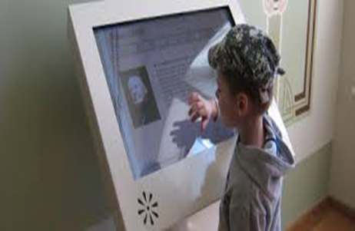
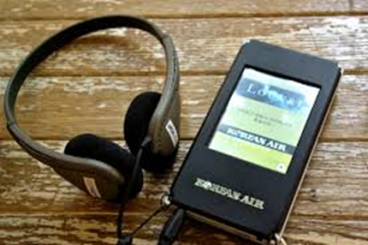
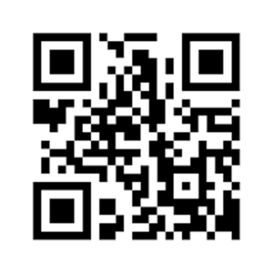
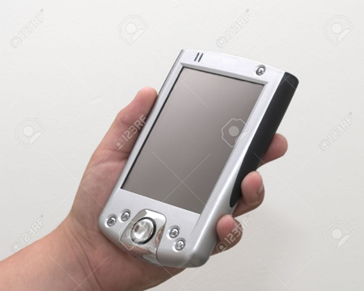
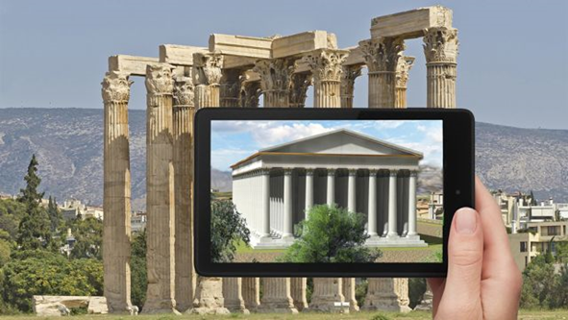
5e. How to do?
Other media
Info-kiosks
Audio-guides
QR codes
Mobile apps

Slide 15
5e1. How to do?
Info-kiosks
Info-kiosks started as an information tool in cities; they consist of digital screens inserted in light architectural constructions, boxes, stands etc. They usually display pre-installed information on specific issues and are not connected to the internet.
They are simple to use (with buttons or interactive screens) and suitable for multimedia content, but they are difficult to maintain and often present problems and need regular maintenance.

Slide 16
5e2. How to do?
Audio-guides
Audio-guides are the immediate “competitors” of tour guides as they can be used by single visitors, small groups or larger groups alike in both covered and open spaces.
The content is provided through special devices connected to earphones. Nowadays, their content can be also found in the form of an app which the users can download to their mobile phone or tablets.

Slide 17
5e3. How to do?
QR code
QR code is a two-dimensional barcode. The initials mean Quick Response, which refers to the time it needs to deliver information once scanned with one’s mobile device.
It was developed by Denso Wave company in Japan in 1994.
In fact it allows the camera of a smartphone to develop into a code scanner once an app is downloaded.
Then this code is transformed into content (either connected to an internet site or autonomously loaded on a server).
It is the latest development, mainly in cultural routes.

Slide 18
5e4. How to do?
Mobile App
The expansion of use of tablets and smartphones allowed for the creation of apps for enhancement of cultural heritage and for more personalized and interactive tour guiding.

